Slide 1
Stephen William Hawking
theoretical physicist, cosmologist, and author

Slide 2
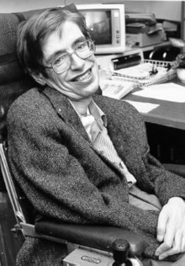
The beginning of a life path
Hawking was born in Oxford into a family of physicians. In October 1959, at the age of 17, he began his university education at University College, Oxford, where he received a first-class BA degree in physics. In October 1962, he began his graduate work at Trinity Hall, Cambridge, where, in March 1966, he obtained his PhD degree in applied mathematics and theoretical physics, specialising in general relativity and cosmology

Slide 3
Hawking's scientific works
Hawking's scientific works included a collaboration with Roger Penrose on gravitational singularity theorems in the framework of general relativity, and the theoretical prediction that black holes emit radiation, often called Hawking radiation. Initially, Hawking radiation was controversial. By the late 1970s, and following the publication of further research, the discovery was widely accepted as a major breakthrough in theoretical physics. Hawking was the first to set out a theory of cosmology explained by a union of the general theory of relativity and quantum mechanics. He was a vigorous supporter of the many-worlds interpretation of quantum mechanics.

Slide 4
Popular science books
Hawking achieved commercial success with several works of popular science in which he discussed his theories and cosmology in general. His book A Brief History of Time appeared on the Sunday Times bestseller list for a record-breaking 237 weeks.

Slide 5
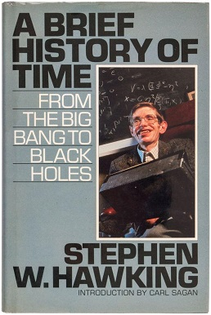
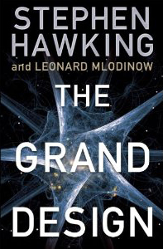
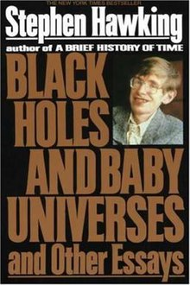
A Brief History of Time
The Grand Design
Black Holes and Baby Universes and Other Essays

Slide 6
On 20 July 2015, Hawking helped launch Breakthrough Initiatives, an effort to search for extraterrestrial life. Hawking created Stephen Hawking: Expedition New Earth, a documentary on space colonisation, as a 2017 episode of Tomorrow's World.
On 28 June 2009, as a tongue-in-cheek test of his 1992 conjecture that travel into the past is effectively impossible, Hawking held a party open to all, complete with hors d'oeuvres and iced champagne, but publicised the party only after it was over so that only time-travellers would know to attend; as expected, nobody showed up to the party.

